Slide 1



Mobile phone cloning
Mobile phone cloning refers to the process of creating a duplicate or copy of someone else's mobile phone without their knowledge or consent.
Created by Deepak

Slide 2
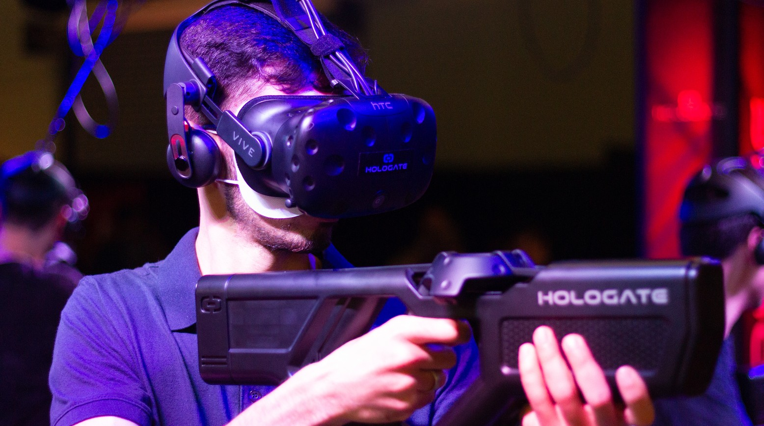


How mobile phone cloning works
Mobile phone cloning refers to the process of creating a duplicate or copy of someone else's mobile phone without their knowledge or consent. This is typically done by intercepting the radio frequency signals that are sent between the mobile phone and the network provider.
Mobile phone cloning was more common in the past when mobile phones used analog technology, but it is much more difficult to clone digital phones. However, it is still possible to clone some older digital phones that have less advanced security features.
Cloning a mobile phone can have serious consequences for the victim, including identity theft, financial loss, and invasion of privacy. It is also illegal in many countries and can result in significant legal penalties for the perpetrator.

Slide 3







Photography
Risks and consequences of mobile phone cloning
Identity theft Financial loss Invasion of privacy Legal penalties
Prevention and protection from mobile phone cloning
Using strong passwords
Avoiding sharing sensitive information over the phone or text message
Being aware of unusual activity or changes in your phone's behavior
Using mobile security software
Mobile phone
cloning

Slide 4
Prevention and protection from mobile phone cloning
Using strong passwords
Avoiding sharing sensitive information over the phone or text message
Being aware of unusual activity or changes in your phone's behavior
Using mobile security software
Historical perspective on mobile phone cloning
Origins of mobile phone cloning
Technological advancements that have made cloning more difficult
Infamous cases of mobile phone cloning
Ethical and legal considerations related to mobile phone cloning
Right to privacy
Criminality of mobile phone cloning
Potential legal and ethical implications for researchers studying mobile phone cloning.
Mobile phone
cloning

Slide 5
THANK YOU

